Slide 1
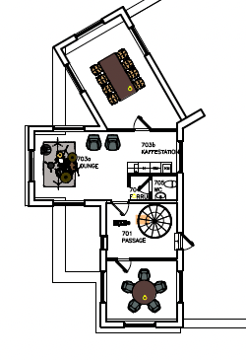
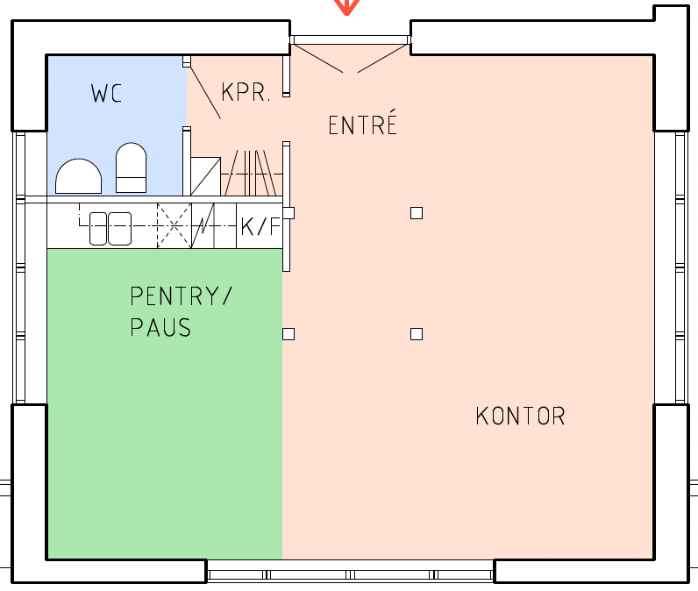
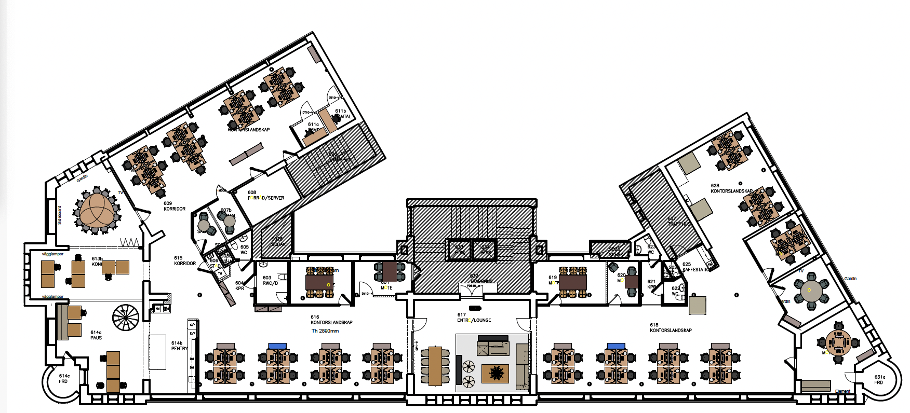
Honeymoon Suite
Conference room names, which are now available for booking in Outlook
Penthouse
Vån 6
Bunkbed
Standard Room
Singel Room
Corner Cabin
The Suite
Vån 5
Sea View
Dark
Room
Family
Room
Double
Room
Junior Suite
Executive Suite

